Slide 1
Cluster Analysis – Wine Sales
MSDS-411 | Fall 2020

Slide 2



As the wine industry continues to grow, how can we use historical data to manufacture the next best wine?
Project Overview
A wine manufacturer is looking to optimize sales by leveraging analytics to support which wines to create and sell
A data set containing chemical properties, historical sales, and customer interest (label appeal) for approximately 12,000 commercially available wines will be analyzed to direct wine manufacturing
Goals & Objectives
Exploratory Data Analysis – Understand today’s wine market
Highlight correlated features – what chemical properties influence one another?
Identify wines that customers like today
Provide recommendation to manufacture around which wine properties levels yield greatest sales
Findings
Two principal components explained approximately 95% of variance
Analysis resulted in 10 clusters of relatively evenly distributed wines
Four of the 10 clusters yield actionable findings
Recommendations
Replicate clusters that are top performers to be confident in increased sales
Run marketing/research campaigns for clusters that are enjoyed by consumers but are not purchases regularly

Slide 3


Clustering allows for a scalable approach around identifying attributes of best-selling wines
Methodology & Modeling Approach
Principal Component Analysis (PCA)
K-Means Clustering
Post-Clustering
Analysis
Original data set has 14 features which are loosely correlated
Leverage PCA for feature dimensionality reduction
Remove target features
Select the appropriate amount of PCs which represents a minimum of 90% variance explained
Leverage clustering algorithm to identify which wines can be associated with one another
Identify the appropriate number of clusters needed to accurately represent the data set
Feed PC scores into model for clustering
Compare and contrast wines within each cluster
Compare clusters against one another, identifying what makes one cluster better than another
Provide recommendation to manufacturer around which cluster to create future wine after
Acid
pH
Alc.
Model Inputs
Model Inputs
Principal Components
Clusters

Slide 4

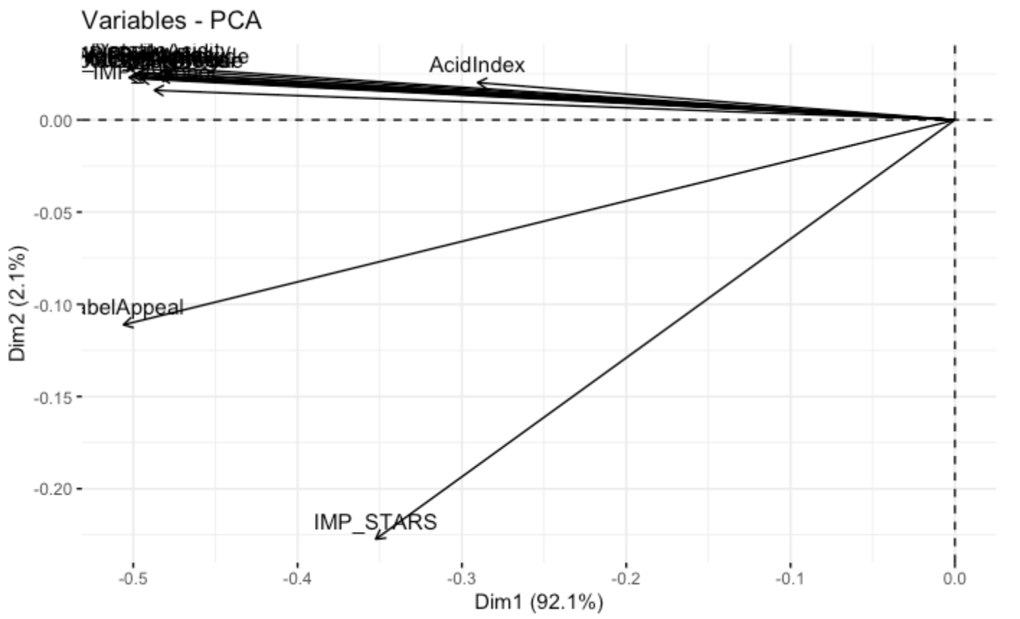
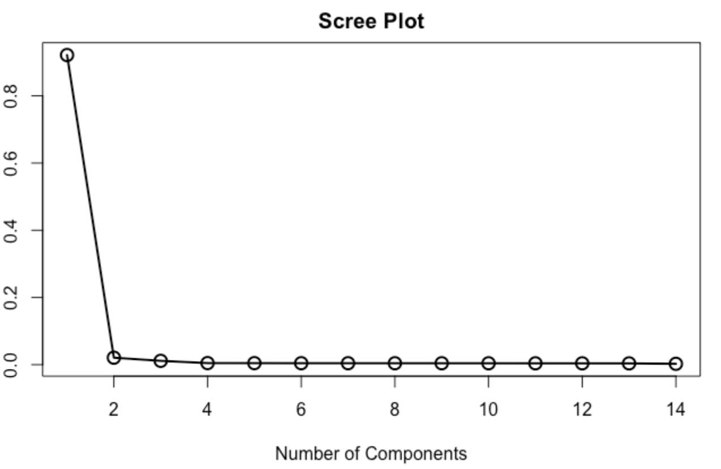
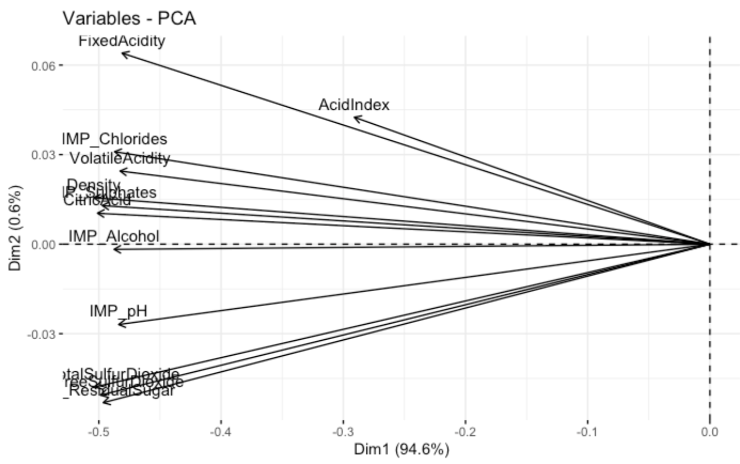
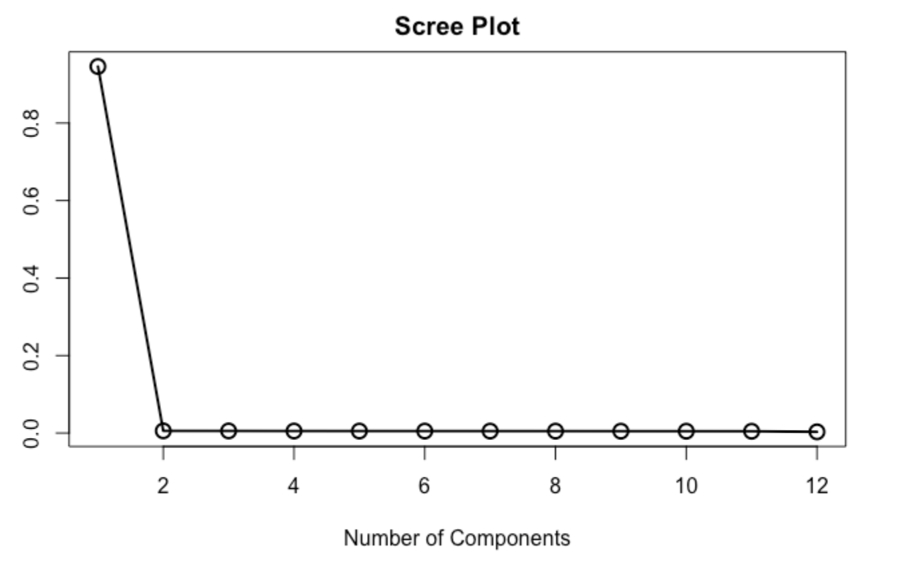
Principal Component Analysis allows for dimensionality reduction, 14 features to 2 Principal Components
Approach #1: All features passed through PCA (besides target variables)
Approach #2: Selected features passed through PCA
Our first attempt is to leverage PCA by passing all variable through the algorithm
We have removed the target variable which indicates sales, as we do not want this feature to influence clustering
The below map shows that the Stars and Label Appeal features are heavily influencing the first Principal Component
All other variables are influencing the second Principal Component
Our scree plot shows that ~90% of variance can be explained by the first component
After understanding the influence of Stars and Label Appeal on PC1, we have removed these features and will attempt PCA again
The map shows a much more distributed feature influence amongst the first two principal components
Variance explained is still heavily influence by the first PC
The scree plot supports the above claim
1
1
2
2
2
3
Map of Features
Scree Plot
Map of Features
Scree Plot
2
1
1
1
3
2

Slide 5
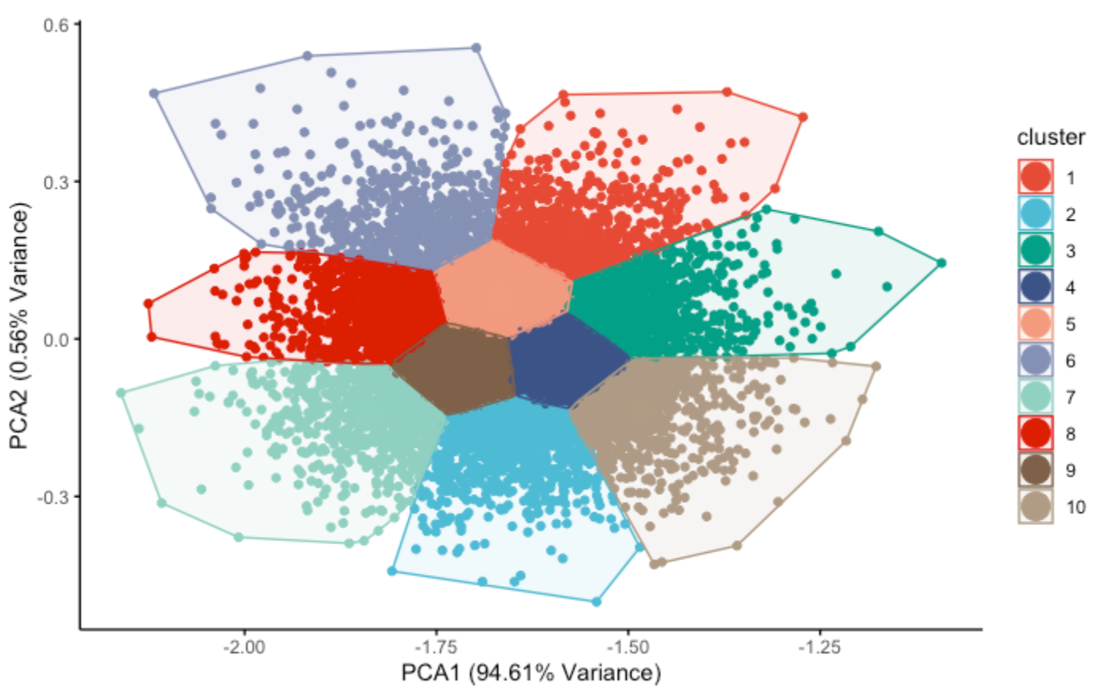
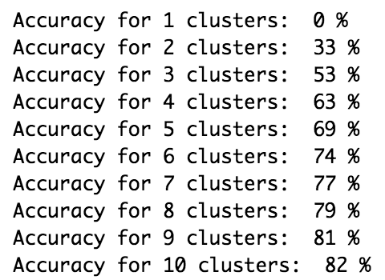
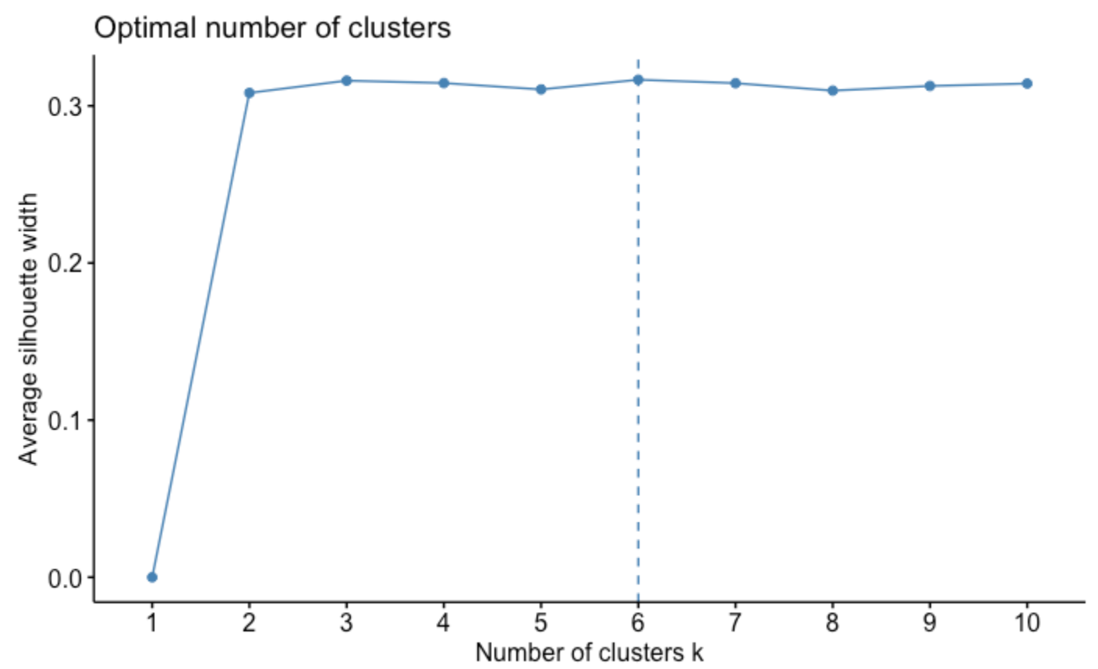
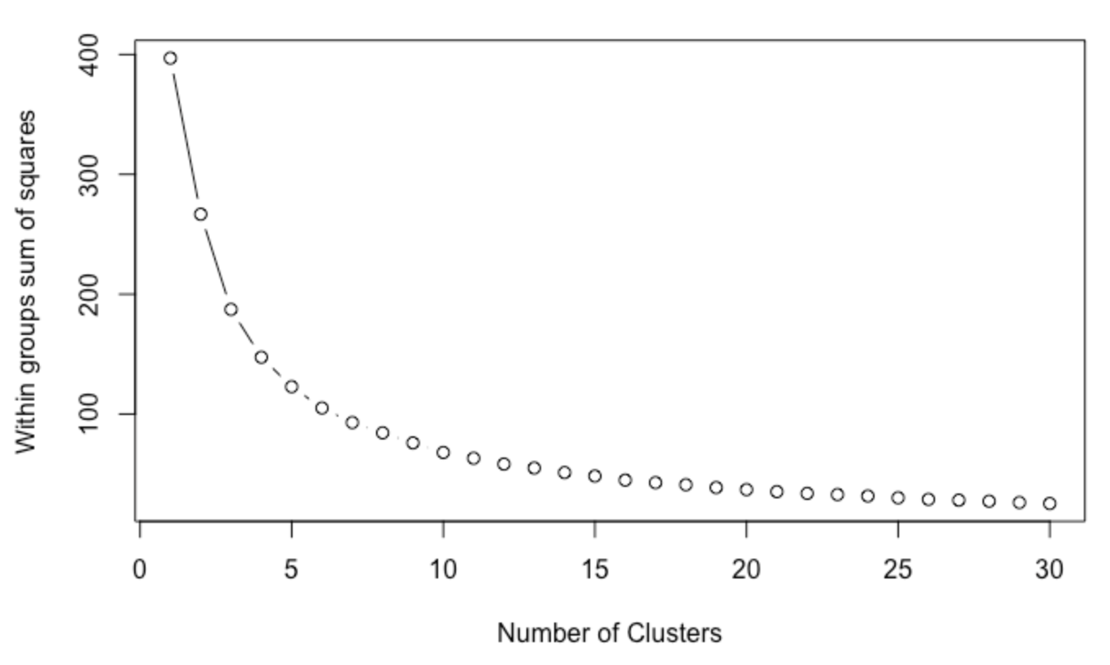
K-Means allows us to group our wines into 10 clusters at approximately 80% accuracy
Cluster selection & Output
Cluster Output
The below elbow plot plot shows the sum of squares (error) associated to the number of clusters derived from K-Means
The plot begins to “elbow” at around 5 clusters, with a continued decrease
As each wine is so unique, the number of clusters can be quite large. We have decided to accept 80% accuracy
Simulations were conducted, looping through clustering options until accuracy threshold was met with 10 clusters
A silhouette score recommends 6 clusters; however, 10 is secondary
Average Silhouette Score
Elbow Plot

